Slide 1
Analysing Job Postings Across Australian Cities Insights into Employment Trends and Opportunities
Presented by Group 6
Jeff He
Giselle Araceli Salvatierra
Larisa Xiang

Slide 2
Project Workflow
Define Project Scope
Search & Gather Data
Draw Conclusions
Develop Insights
Analyse Findings
Clean Data & Conduct Research

Slide 3
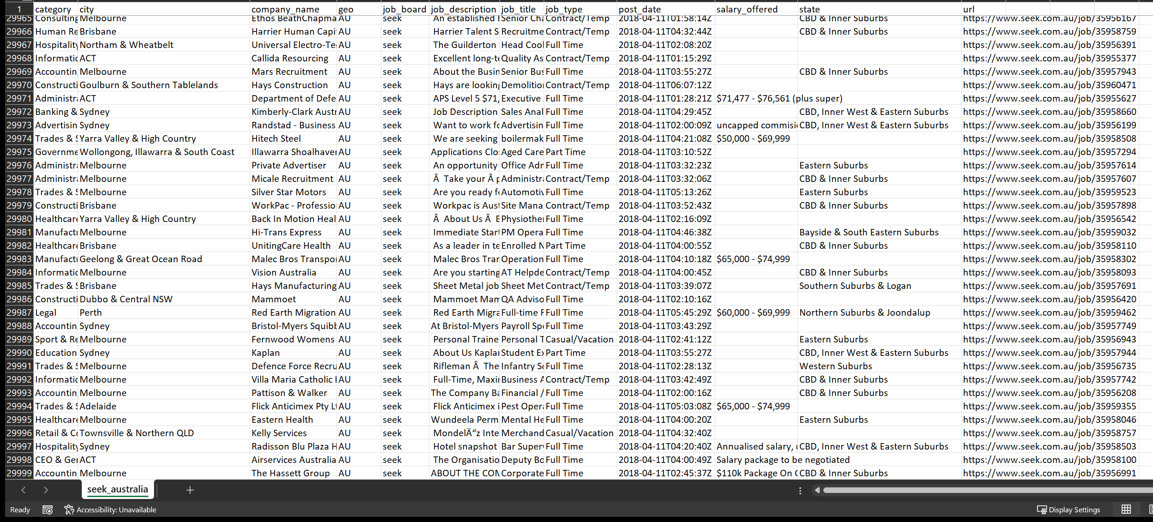
Resource
12 columns
Job postings from SEEK Australia website
30,000 rows
https://datasetsearch.research.google.com/search?src=0&query=seek%20Australia&docid=L2cvMTFqOWIzbXFoZw%3D%3D

Slide 4
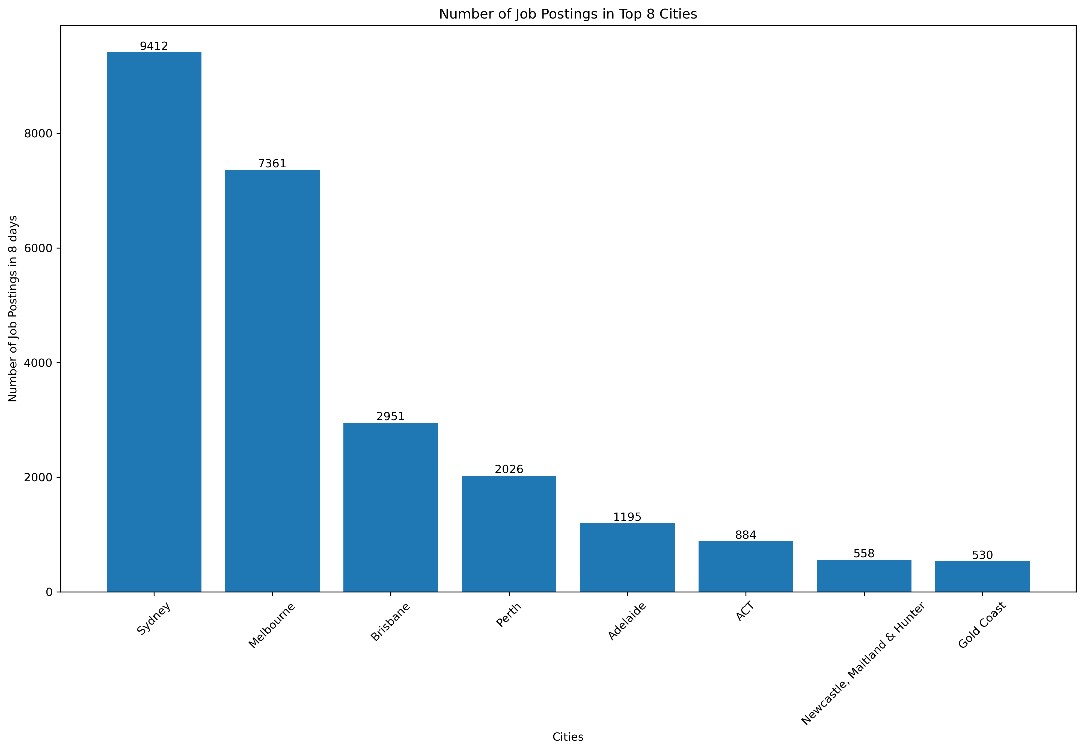
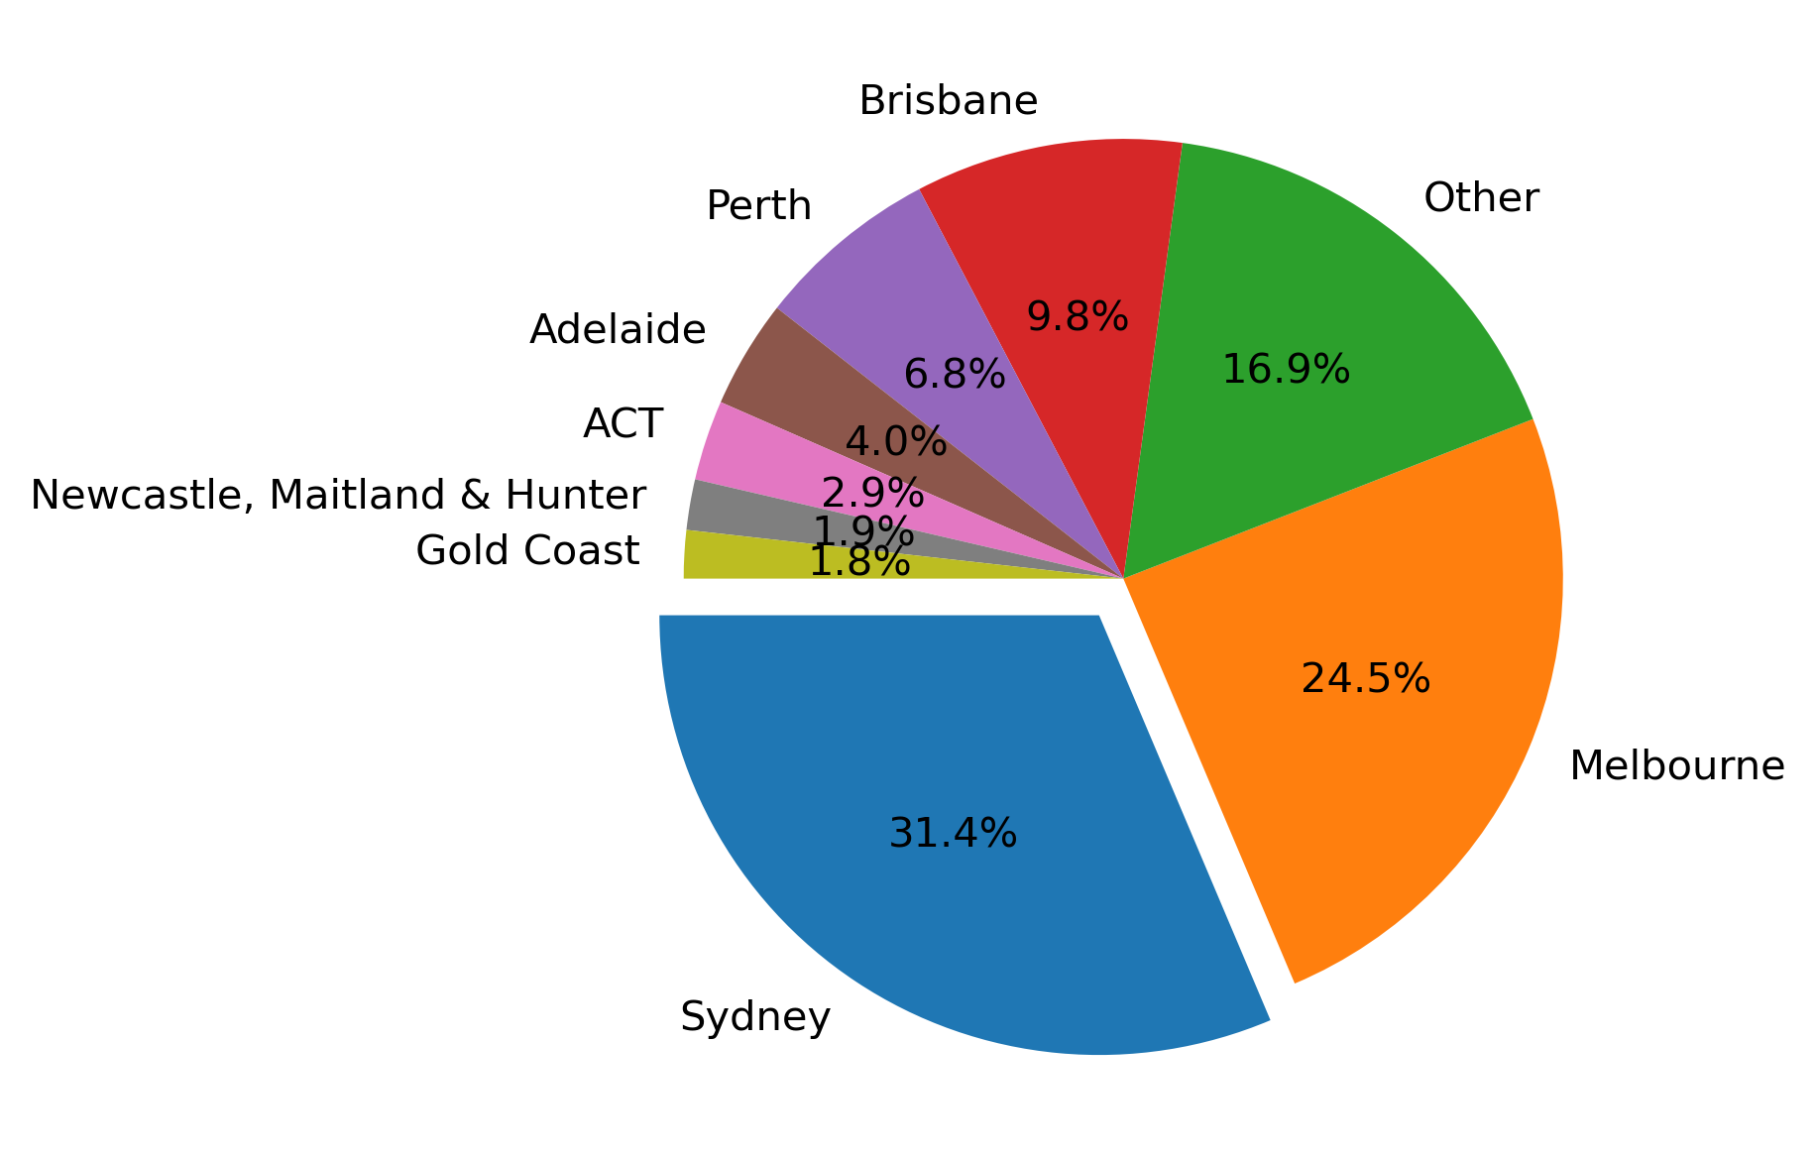
Q1: Which cities have more job opportunities?
Job Market Size: Sydney and Melbourne stand out as the cities with the highest job posting activity, having 9412 and 7361 job postings respectively. The higher job postings are likely driven by their stronger economies, leading to more job opportunities.
State Capitals: Sydney, Melbourne, Brisbane, and Perth are state capitals and often exhibit higher job opportunities due to their economic significance.
Smaller Cities: Adelaide, ACT (Canberra), Newcastle, Maitland & Hunter, and Gold Coast have comparatively lower job posting numbers. These cities might have smaller job markets or specialised industries.

Slide 5
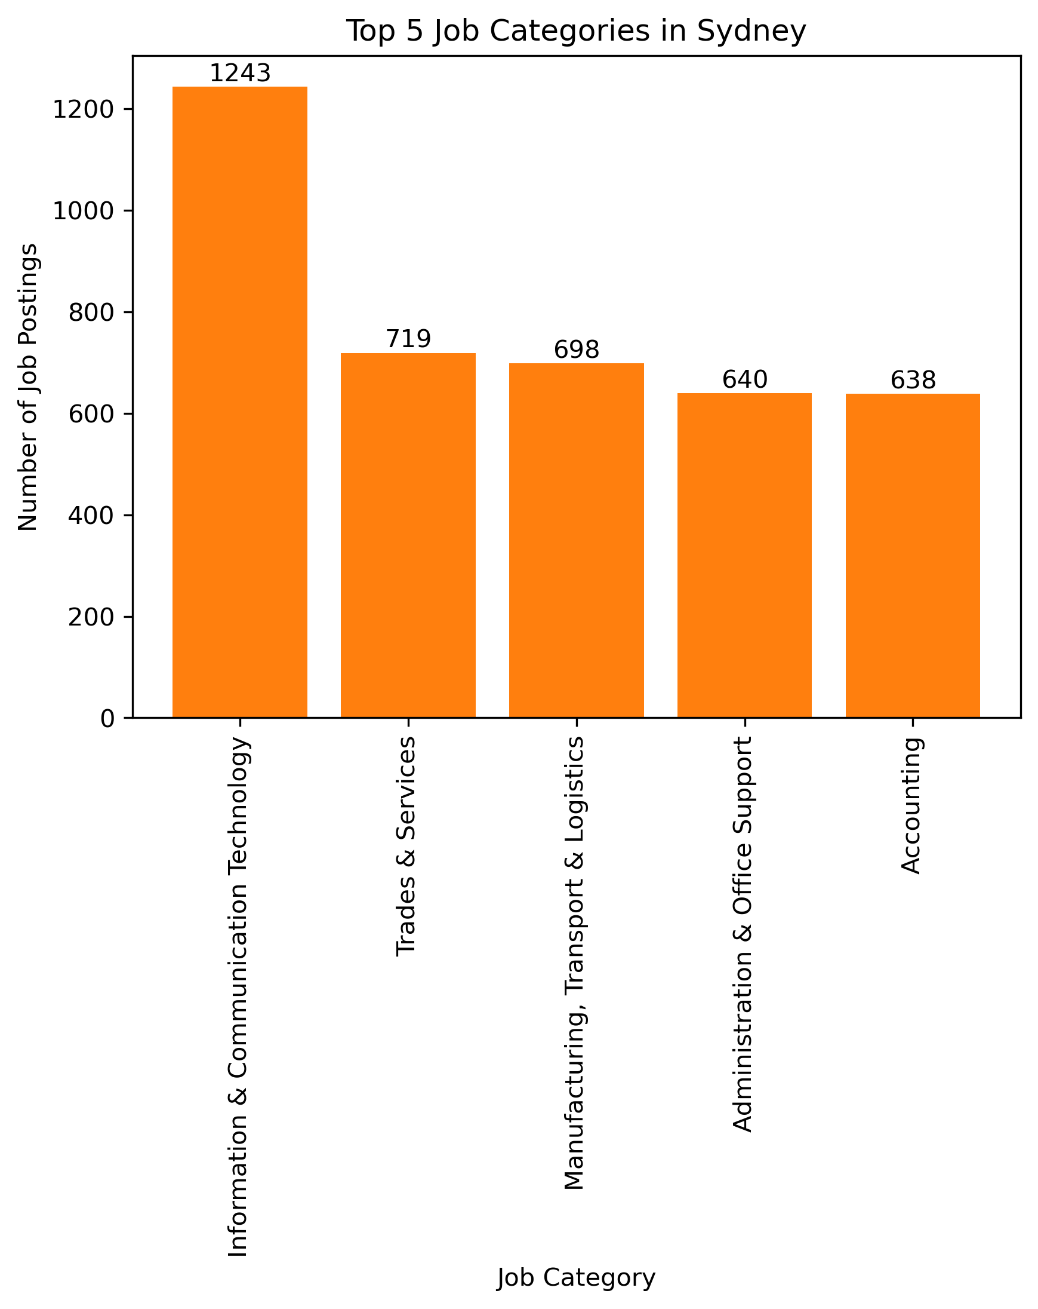
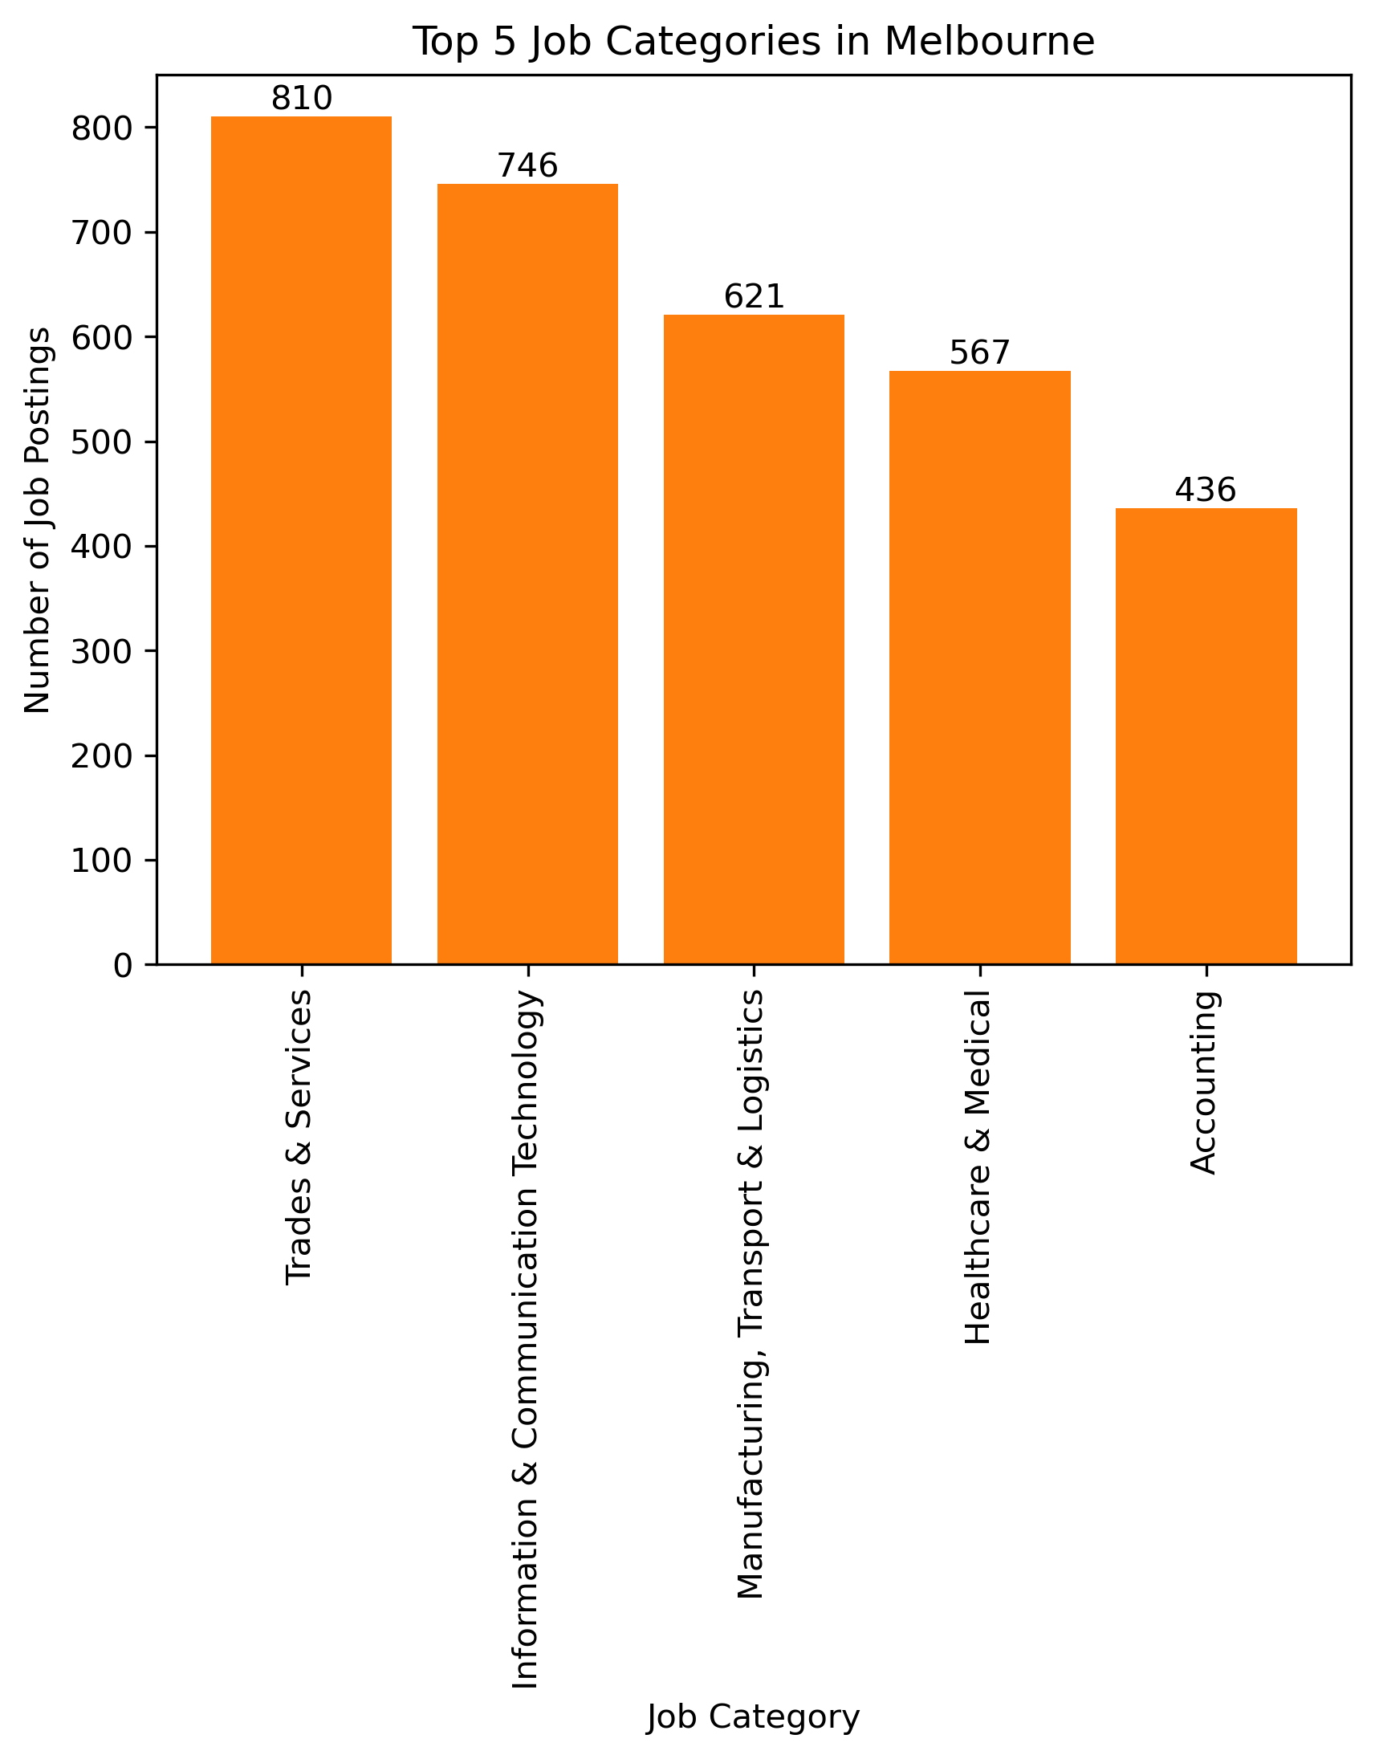
Q2: Which categories are ranked in the top five?
Information & Communication Technology
Trades & Services
Manufacturing, Transport & Logistics
Administration & Office Support
Accounting
Trades & Services
Information & Communication Technology
Manufacturing, Transport & Logistics
Healthcare & Medical
Accounting

Slide 6
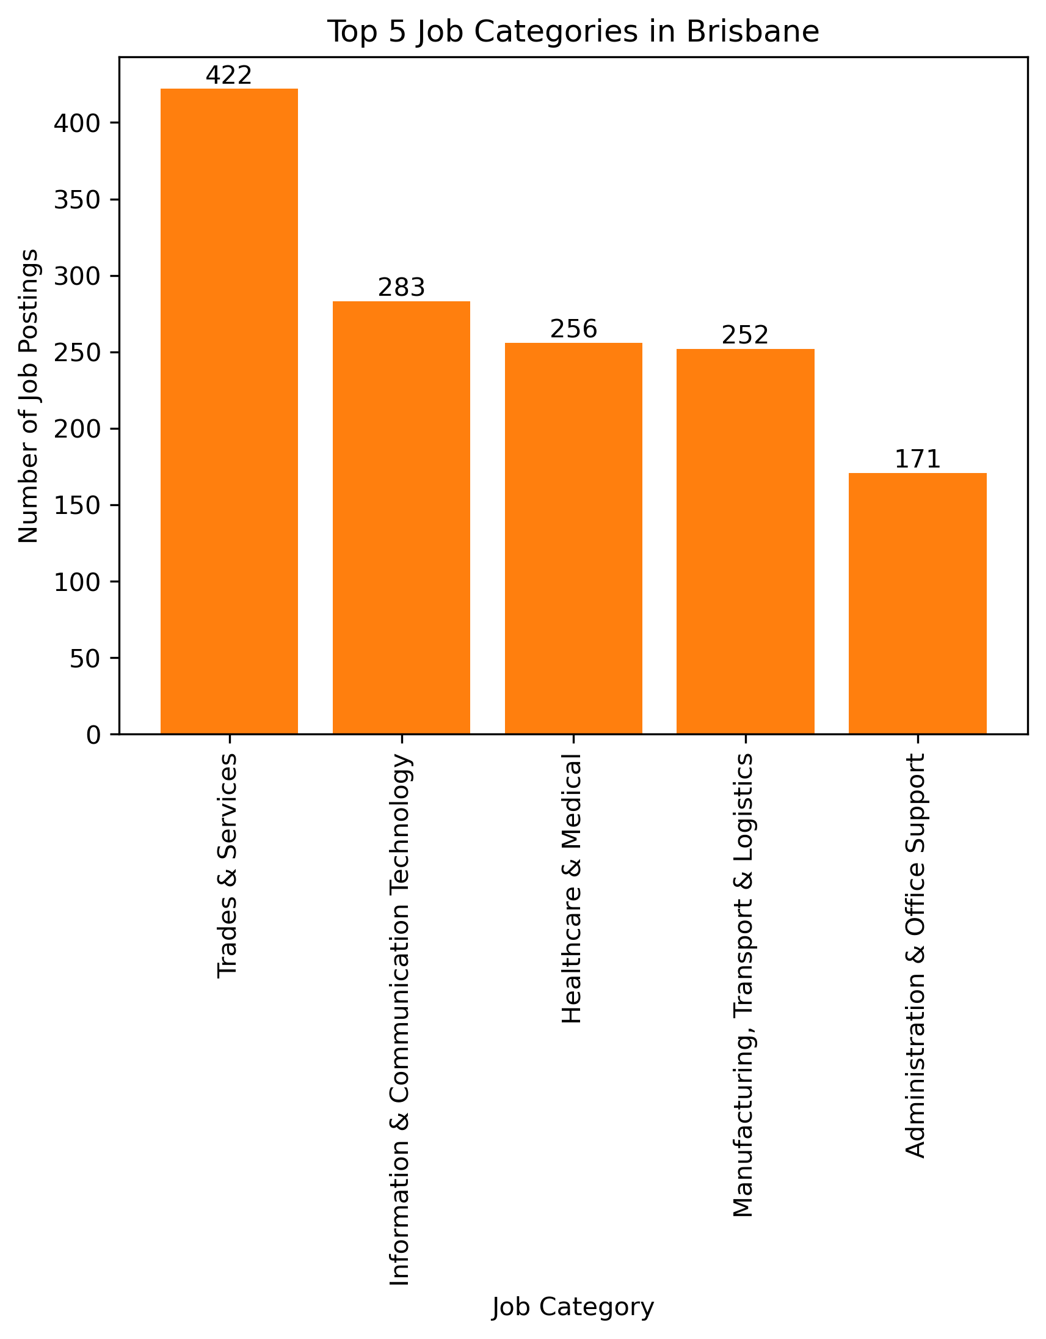
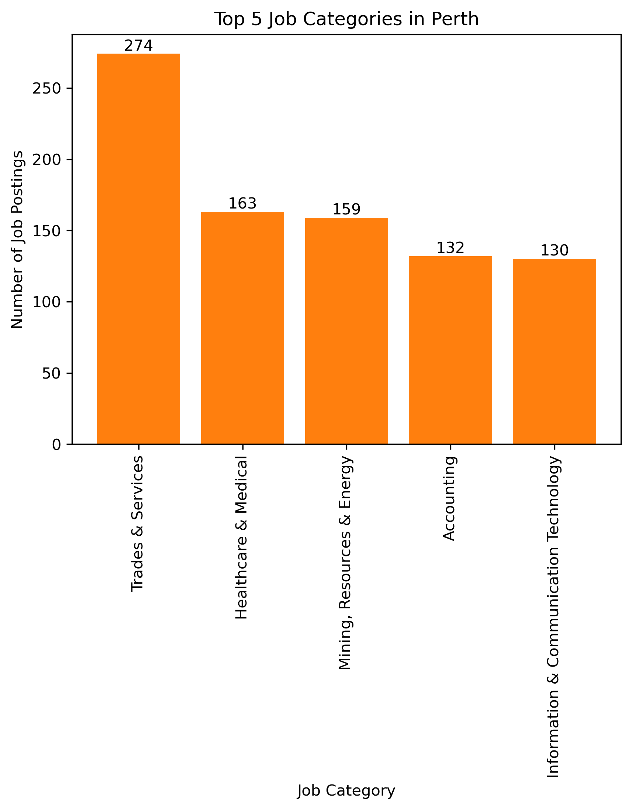
Trades & Services
Information & Communication Technology
Healthcare & Medical
Manufacturing, Transport & Logistics
Administration & Office Support
Trades & Services
Healthcare & Medical
Mining, Resources & Energy
Accounting
Information & Communication Technology

Slide 7
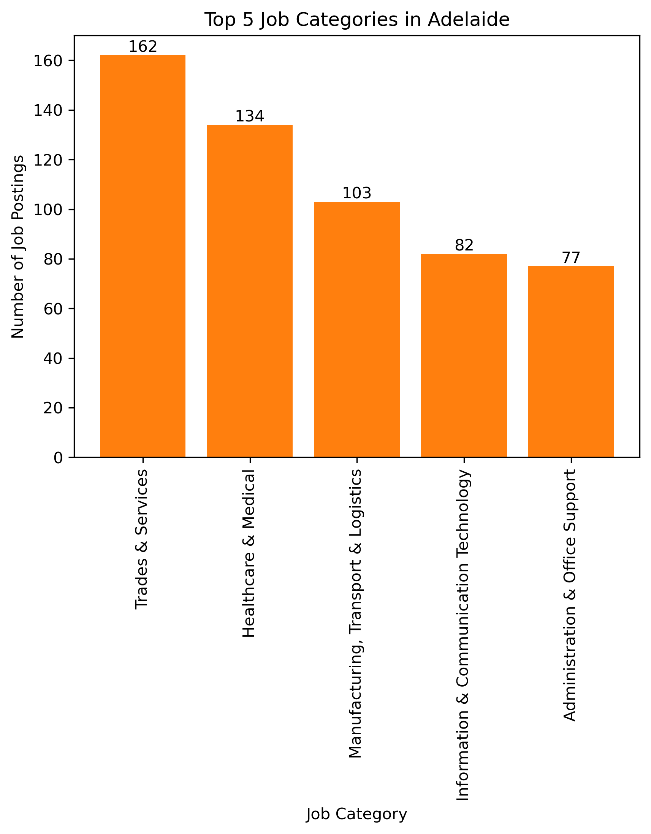
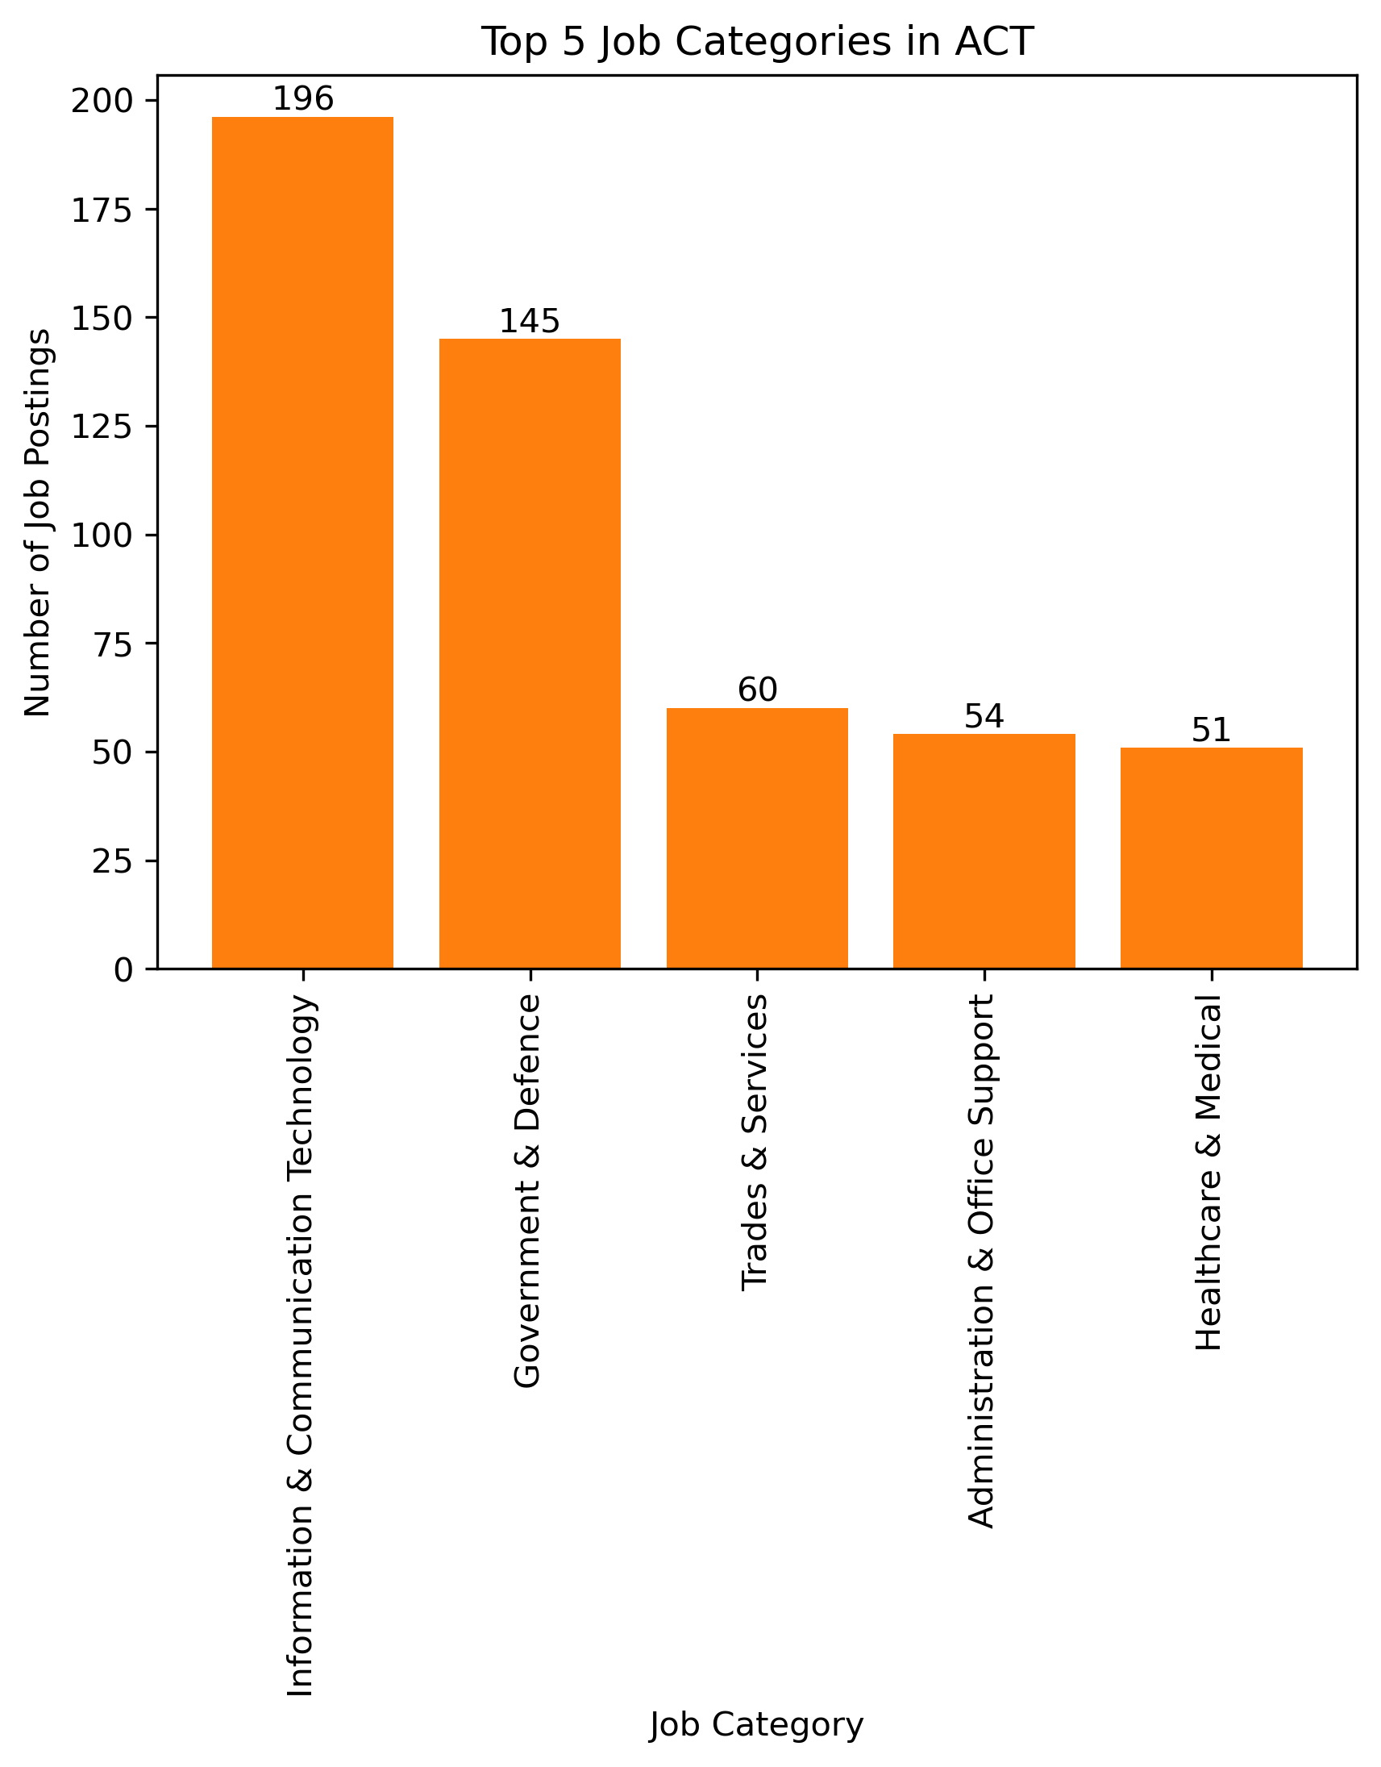
Trades & Services
Healthcare & Medical
Manufacturing, Transport & Logistics
Information & Communication Technology
Administration & Office Support
Information & Communication Technology
Government & Defence
Trades & Services
Administration & Office Support
Healthcare & Medical

Slide 8
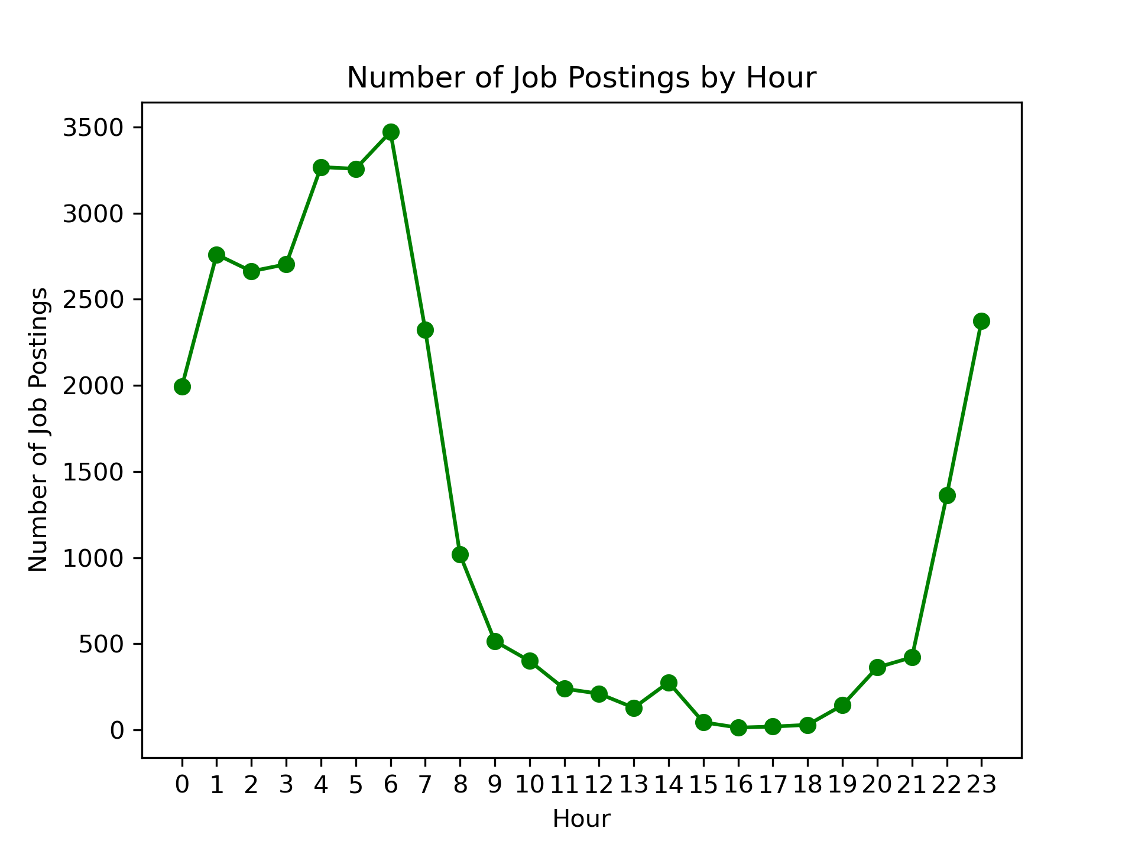
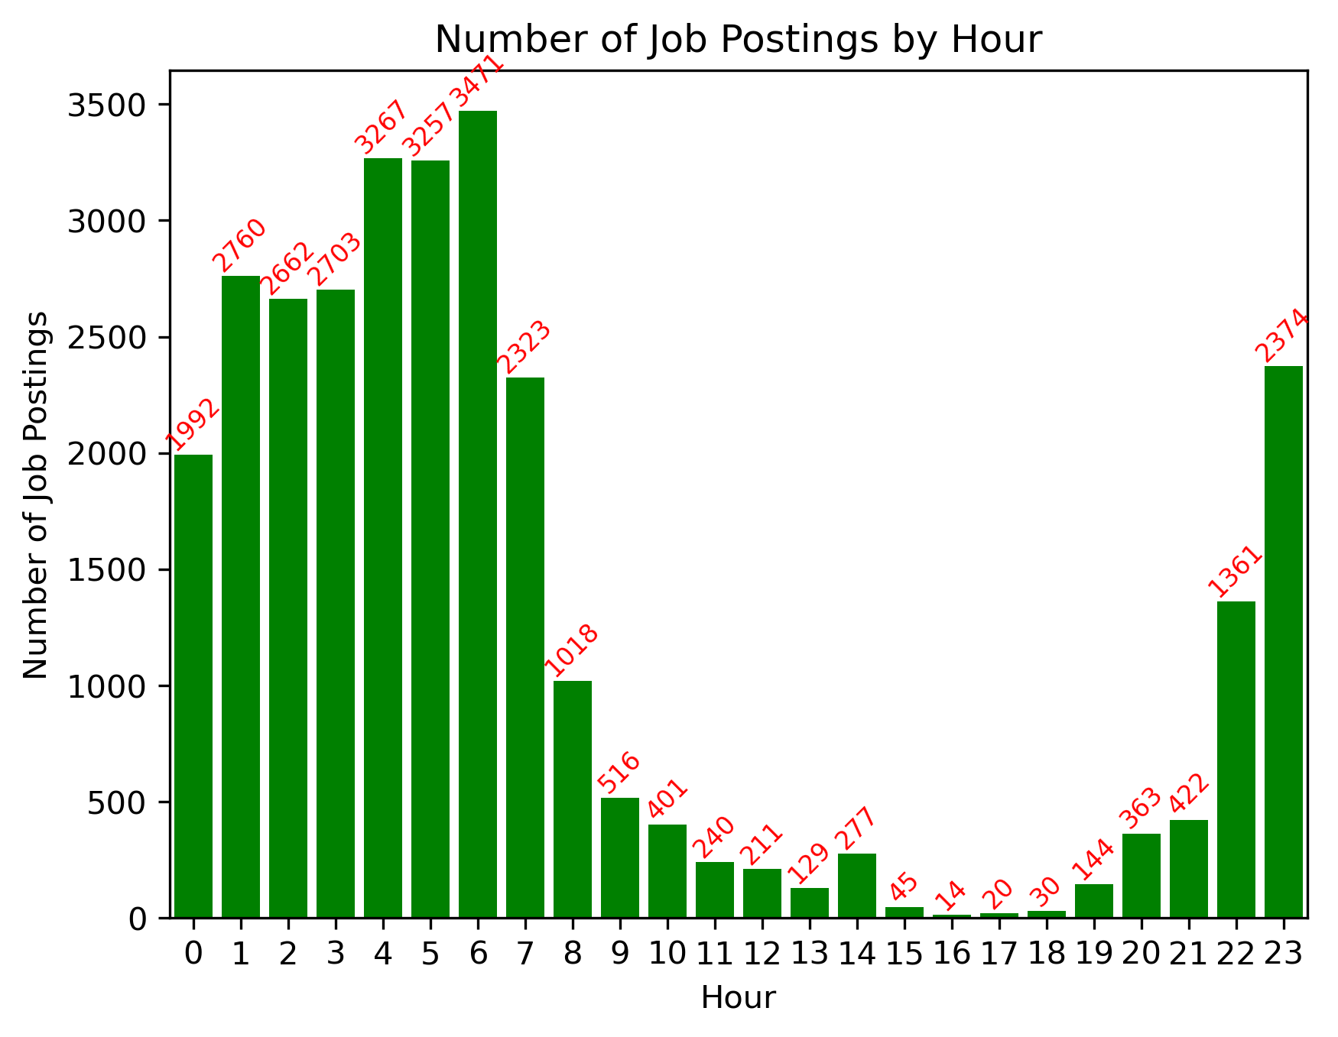
Q3: When does opportunity knock?
Early Morning and Late Evening Peaks: There are notable peaks in job postings during the early morning hours (around 6:00) and the late evening hours (around 22:00 to 23:00).
Quiet Hours: The hours between 15:00 and 18:00 have relatively lower job posting activity.
Working Hours Impact: Job postings tend to be lower during traditional working hours (9:00 to 17:00).

Slide 9



Conclusions
Geographical Concentration: The bulk of the job offerings are heavily concentrated within the top five cities, namely Sydney, Melbourne, Brisbane, Perth, and Adelaide.
Diverse Demand: Further analysis has shown the varying job category preferences across each of the five prominent cities. When focusing on Adelaide, where a substantial portion of our peers reside, we've noticed that the 'Information and Communication Tech' category ranks fourth, comprising roughly 80 posted job offers. In contrast, this category takes the lead in Sydney, boasting nearly 16 times the count of Adelaide. Moreover, it secures the second position in Melbourne with a significant 750 job listings.
Optimal Timing: Our analysis has also revealed the ideal time for job seekers to commence their search. Prior to this analysis, the presumption might have been that most jobs are posted around midday, however, our findings contradict this. Instead, most of the job opportunities tend to surge between 10 pm and 7 am on the following day.

Slide 10

Any questions?

